Slide 1
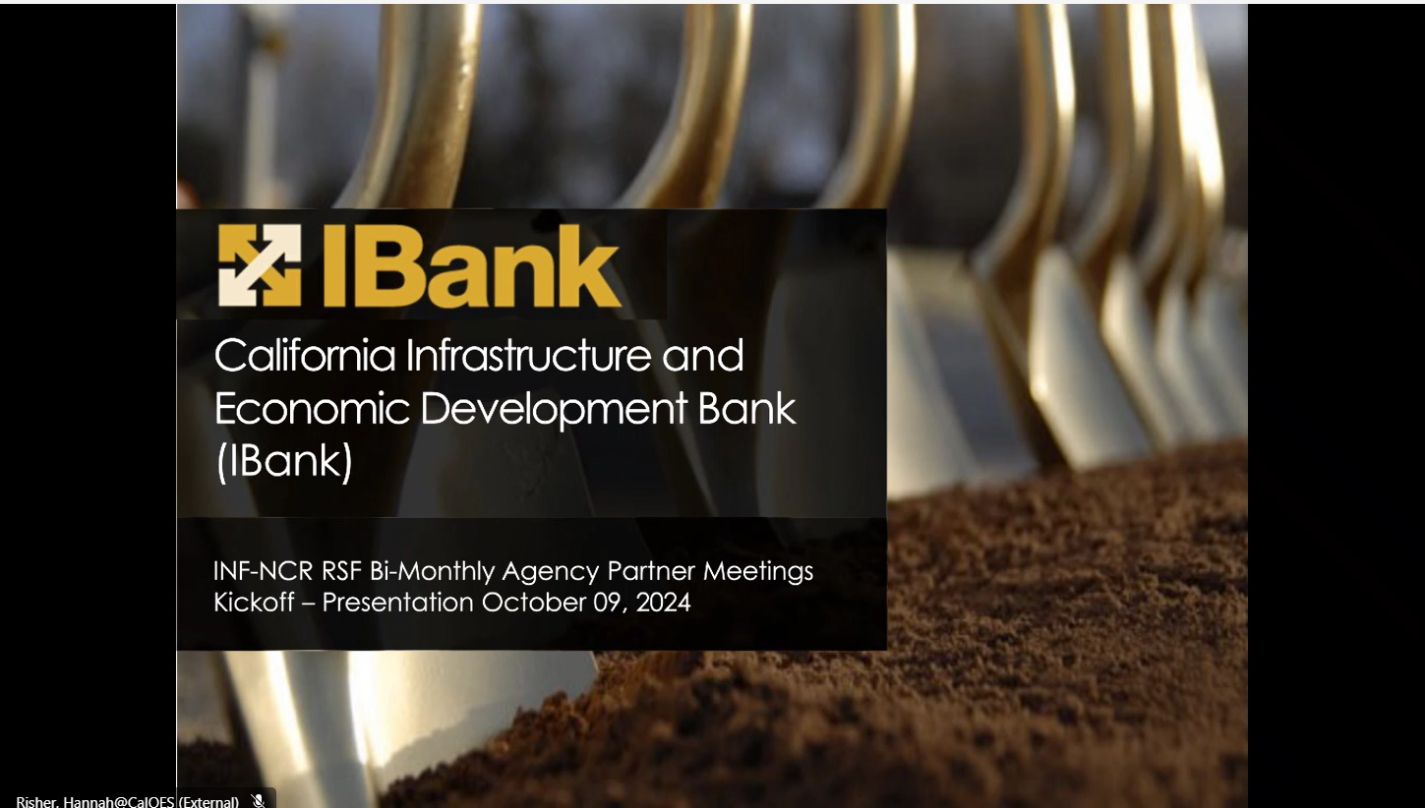
1

Slide 2
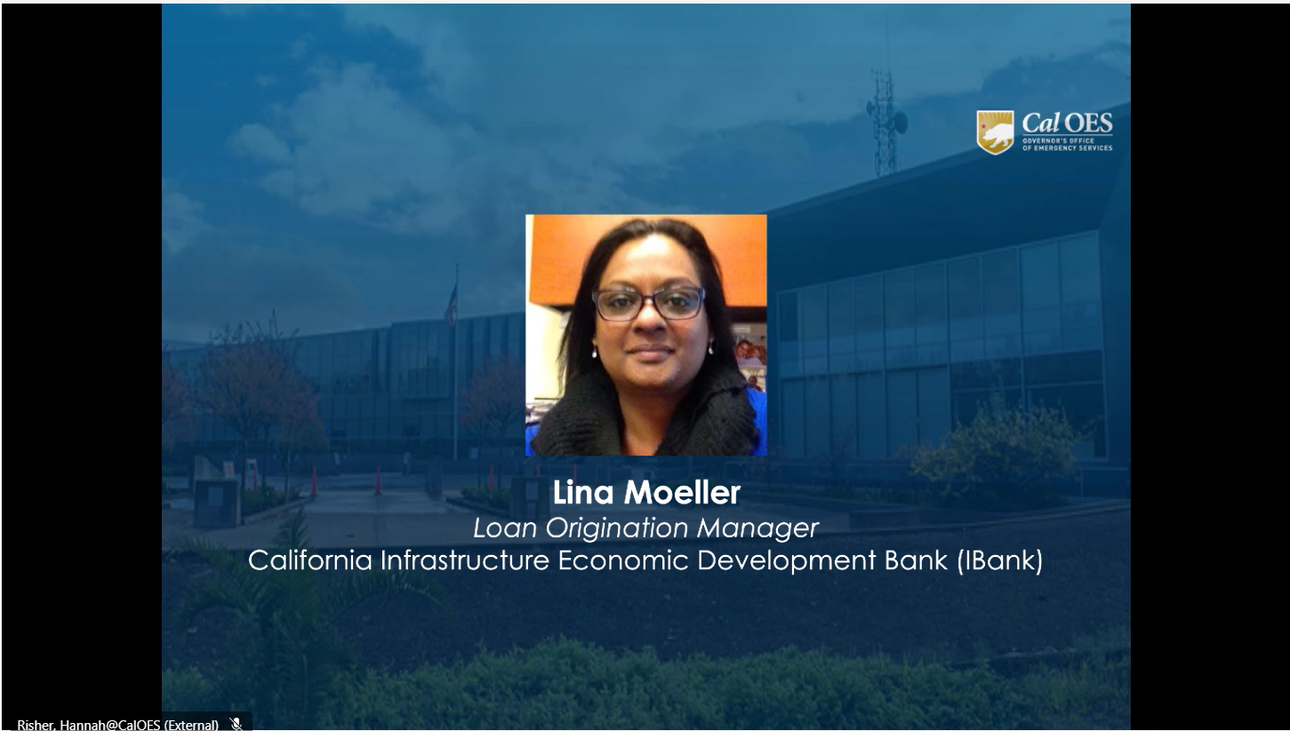
2
Notes:
Lina Moeller from the California Infrastructure and Economic Development Bank, or IBANK for short, will introduce herself and the program that she is a loan origination manager of the infrastructure state revolving fund program.

Slide 3
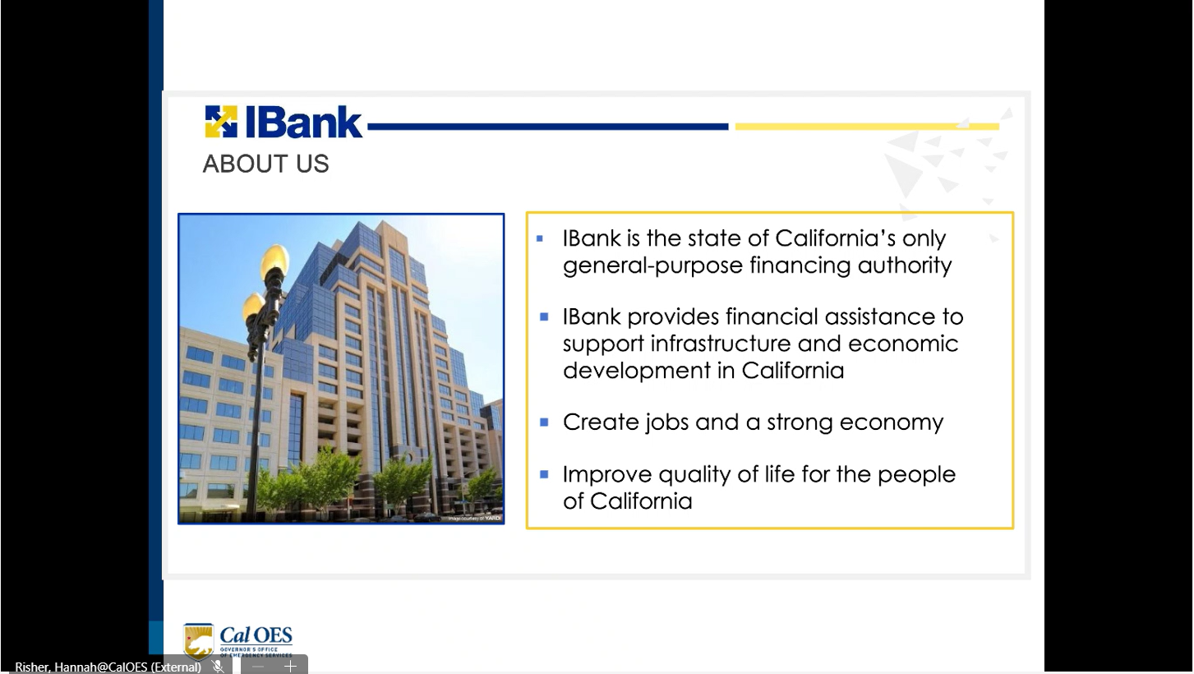
3
Notes:
I'll give you a brief overview of IBank as a whole and our different units and then a little bit more specific information on the actual eligibility requirements process how we do things are competitive.
IBank was created back in 1994 mainly to provide low cost financing to the citizens of California for a wide range of infrastructure projects, we are a state agency. We fall under the Governor's Office of Business and Economic Development. We have three main areas of focus:
1) creating and preserving jobs in California, expanding access to underserved communities.
2) we want to be inclusive and intentional in lending to businesses and local governments in underserved areas in California, and
3) addressing climate change.
We are expanding our role in climate financing and we are investing and enabling more projects that address the climate crisis in a meaningful way.

Slide 4
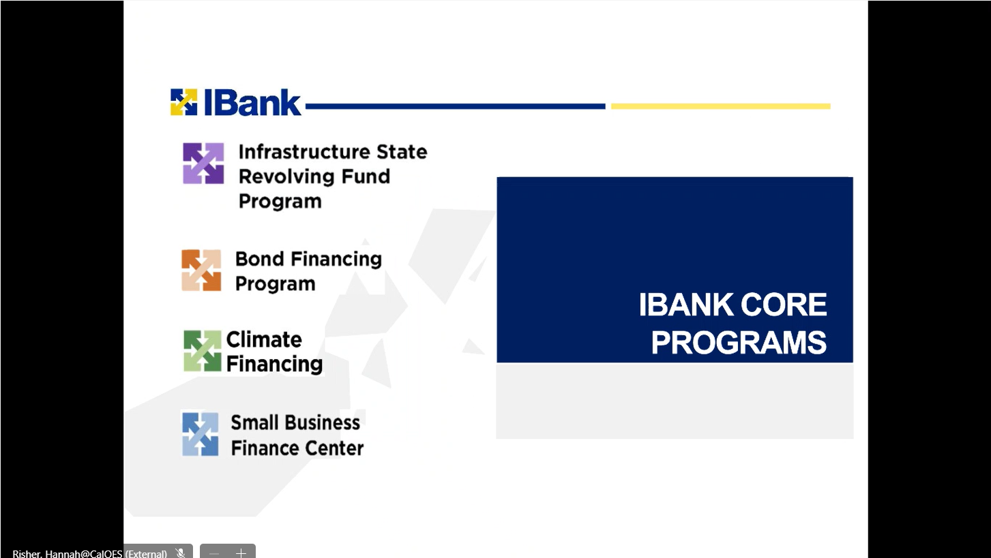
4
Notes:
Our main core programs within IBANK. Focus more on the purple icon, which is the ISRF program and if you would like to find a little bit more detail on all the other programs, we have a fantastic website at ibac.ca Gov where you can there's a landing page for each of these programs and it gives you details and contact inform and examples of projects that have been done.
With regards to climate financing, we are aligning our goals and missions to the state's goals for greenhouse gas reduction, water conservation and environmental preservation. We have a climate financing unit that works with these kind of projects and it's also now a green bank for California.
We have a bond unit: bond financing program. It's a general purpose conduit bond issuer and our bond unit facilitates issuance of tax exempt and taxable bonds for various public or private sector projects. We have capacity to issue really large projects over a billion dollars in bonds can be issued.
Also have a small business finance center which works through financial development corporations to offer loan guarantees to lenders, who in turn lend to small business owners.
Also have a new venture capitalist program, which also has a lot of venture capital and startup projects that can be helped with that program.

Slide 5
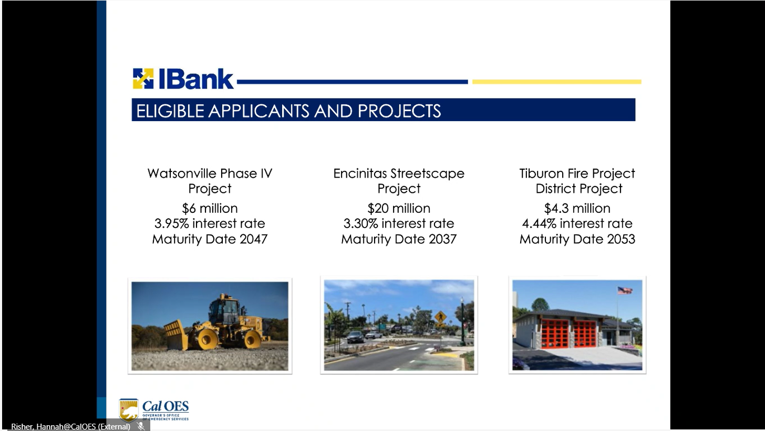
5
Notes:
Can bridge the gap in financing. If you've got projects out there where you have grants or other sources, both federal and state, and your project cost is higher than what you have received in terms of grants, we can help with bridging that gap in financing.
We can lend to any subdivision of a local government, including departments, agencies, cities, counties or special districts. We can also lend to joint powers of authority and nonprofits, under the right circumstances. We need we need to talk a little bit more when nonprofits are involved. We have certain criteria that have to be met. For example, the nonprofit has to have really strong ties to the public entity. Either having been formed by the public entity itself or the public entity is providing subsidies to the nonprofit or the public entity is willing to step in and be a coborrower, or a guarantor for the project. Or let's say there's a subsidy in land that's given to this project. The public entity is doing a borrower's resolution for the project, so there's different levels of interaction between the public entity and the nonprofit.
Highlight a few projects that we have done here to give you an idea of the type of projects we do, what our interest rates typically are and what the terms are.
1) The first picture there you see is a project we did for the city of Watsonville. It's an SP1383 project. The SP183 mandate relates to organics processing. The project consisted of a new landfill and it included green and wood waste processing plant and also equipment that was purchased for the project. Talking about SB1383 projects, we have actually done a handful of these projects. We did a transfer station project for the Sacramento County. We did a large landfill project, $40 million for the city of San Diego.
2) The second picture that you see is for a streets project for the city of Encinita. The project included enhanced crosswalks, raised medians, roundabouts, rehabilitation of roads is also a project. Especially under this particular banner that we are presenting here today in this forum, if roads need upgrading, repair, all of that are eligible projects.
3) We also do fire stations. We did a project for the Tiburon Fire Protection District which included over 5000 square feet of A 2-story fire station building.
There's different kinds of loan structures and I'll go over that a little bit later as well.
We can finance 100% of the project.
Soft cost and hard costs.
Design costs hard construction - cost related to a project are eligible under these
We do require a borrower's resolution before we finance these projects. The borrower's resolution will allow the local government to include costs that they have incurred up to 60 days prior to the date of the borrower's resolution into the loan that we finally do.
The one project type that is ineligible under the program is housing. For local governments that are having huge numbers of homes being built, we cannot build the homes or anything that's on private or development owned land. But we can do infrastructure around the housing, so roadways, ramps, LED streetlights, landscaping, water and sewer pipelines, water treatment plants, everything up to the housing line are all eligible, so these projects would be. On public land and the borrower would be the public entity.

Slide 6
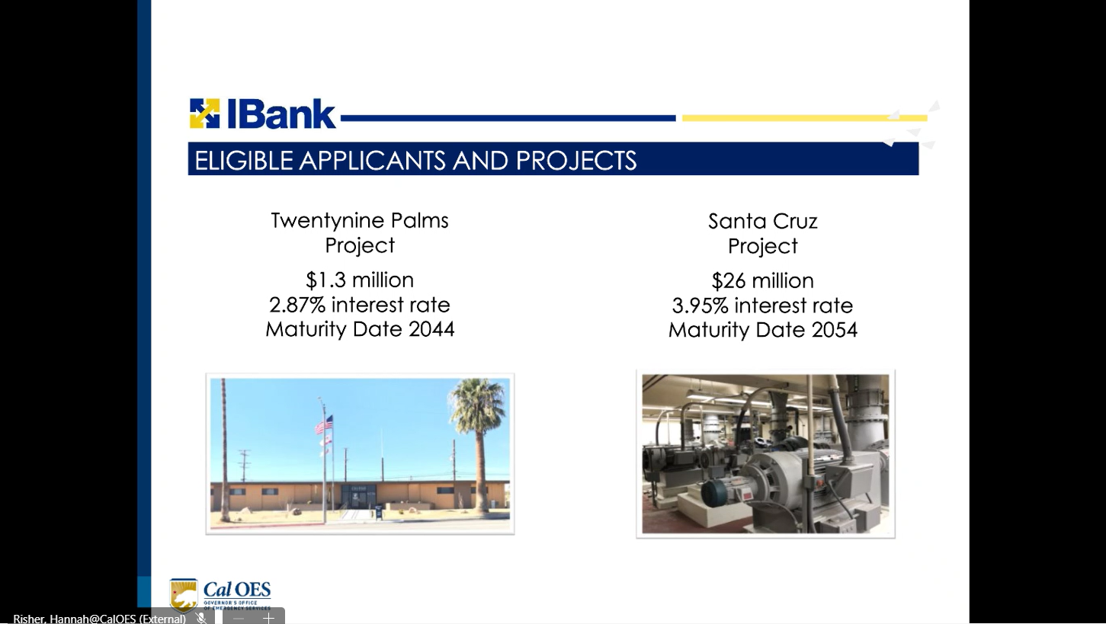
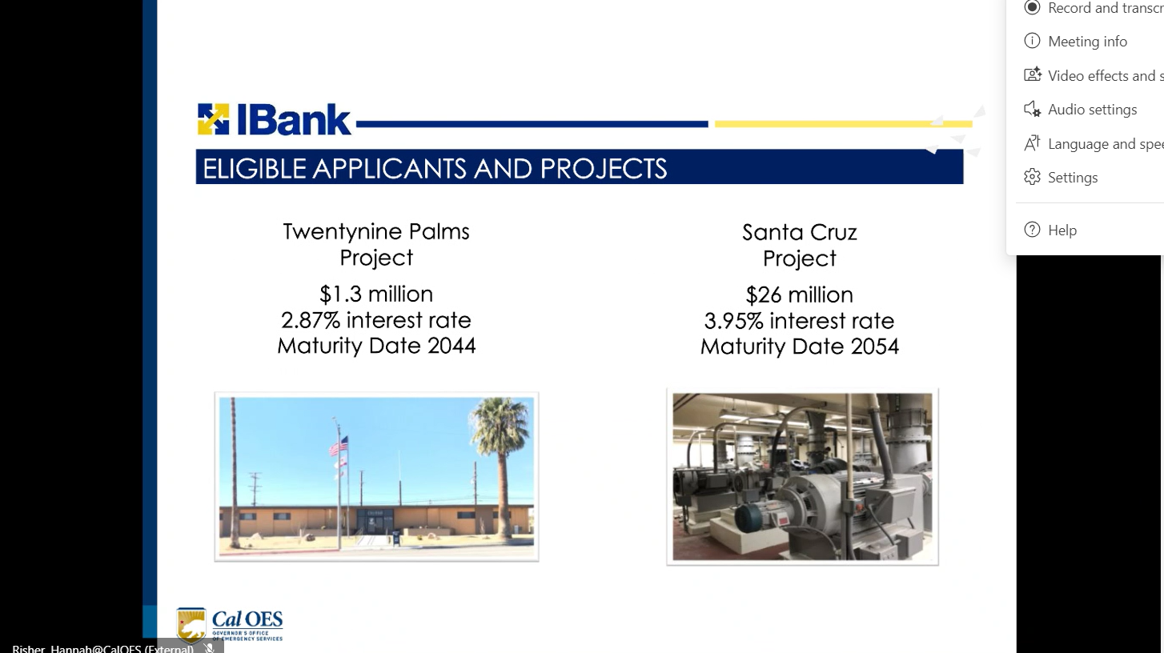
6
Notes:
Highlight a couple of additional projects here.
1) The city of Santa Cruz Project is a 20, nine, $26 million project that was just approved this month by the IBANK board. It included wastewater treatment system upgrades for the city of Santa Cruz to ensure that stormwater and wastewater was disposed in a clean and healthy way so they were not affecting the ocean space or the beach space in in Santa Cruz.
- we can go loans up to 30 years on these projects as long as the useful life supports it.
2) The other project there is the 29 city of 29 Palms Project. It was a $1.3 million project for installing solar panels in city owned buildings. It was three or four buildings that were owned, like administrative buildings such as City Hall and other community services buildings, and they upgraded it with the solar panels and refinanced all those panels.

Slide 7
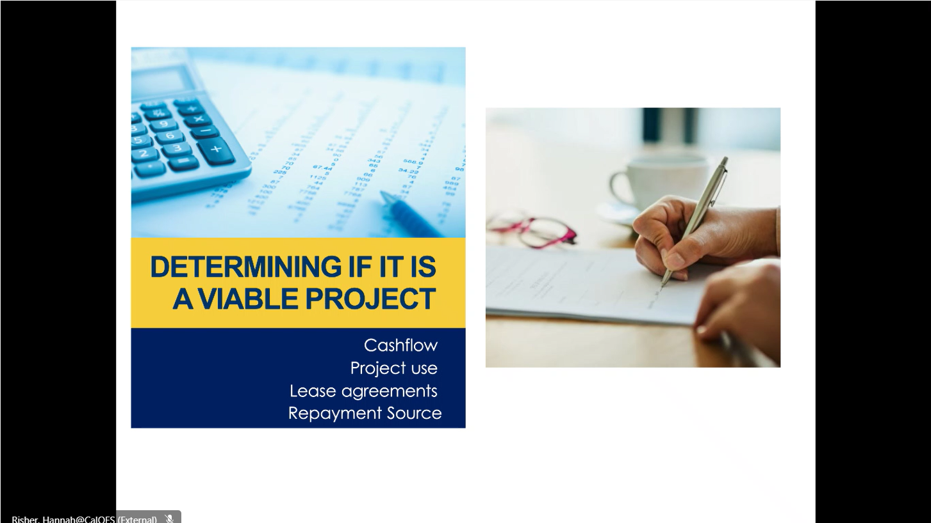
7
Notes:
how do we determine and how do we underwrite? What are some of the criteria that we look at as far as financial analysis?
We will typically look at five years of annual comprehensive financial reports. We also can look at audited financial statements because some smaller water districts do the audit financial systems.
We can also consider projections when we do these projects, especially when you're looking at water wastewater projects.
Many of the projects are financed by rate increases so we do some due diligence to make sure the rate increases are in place and we'll compare them to nearby systems.
Make sure your populating process is completed and then these are so many of these projects are projection based projects.
As far as the project use, our loans are usually tax-exempt loans. Our bond unit issues is of bonds for us and we use those bond monies to then lend to various municipalities and local governments.
Now if there's a portion of the project that has private activity then we would use our own balance sheet equity to fund the taxable portion of these loans or if it's a really large project we would also consider potentially issuing a taxable bond.
There's two types of loan structures:
If there's an enterprise fund that's a repayment source. So for example, you've got a water project or a waste water project that the repayment source is, the water fund or the wastewater fund, we take a pledge on those system revenues directly, so that is our security on these loans.
If it's a general fund project like a roadway project or a fire station Community Center project, we will do a lease leaseback type financing where you can take the project itself that being built as the leased asset or we recommend an unencumbered asset that the city owns as the leased asset.
For example, if you're building a police station, you can use the project itself that's being built as the leased asset, in which case you will incur capitalized interest costs included in the project, but if you give us an unencumbered asset that's not being built that actually is in service, then that property can be the leased asset and then you don't incur capital interest.

Slide 8
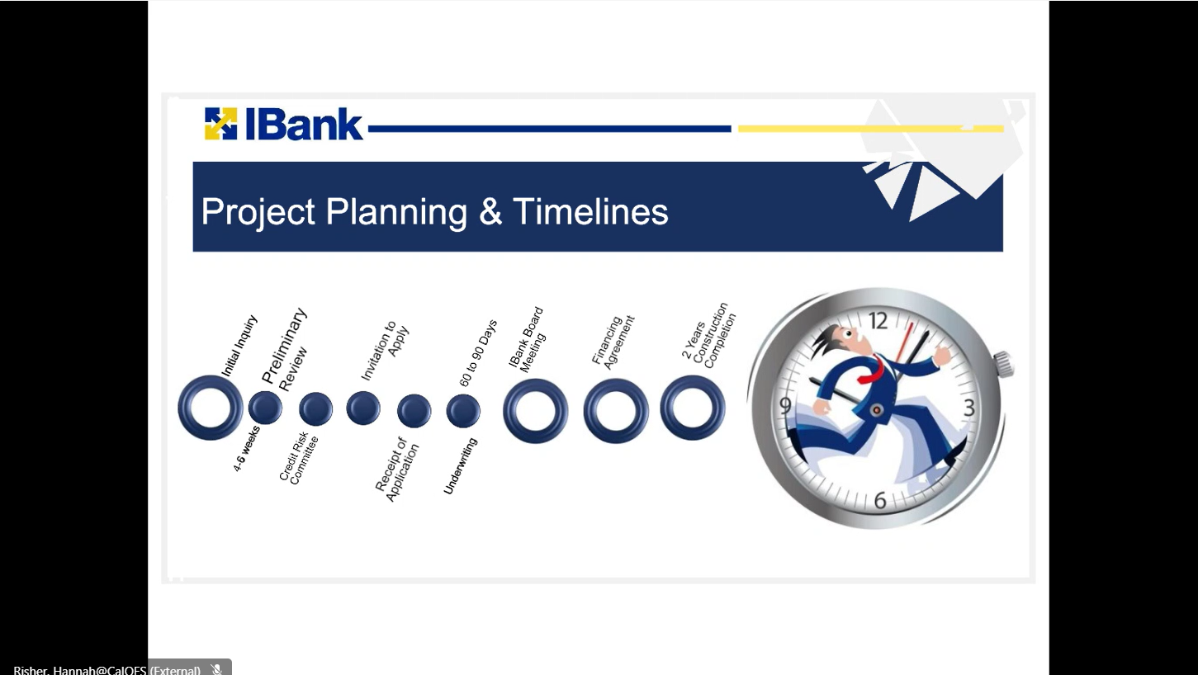
8
Notes:
Overview on our process.
We do an initial enquiry process where we'll have a conference call with the city officials and people involved in the project.
We then complete a preliminary review.
We do quite a bit of underwriting, I would say more than 70-80% of the underwriting is done during the review phase.
This is the time frame when our loan officers do an initial enquiry process where we'll have a conference call with the city officials and people involved in the project. We then complete a preliminary review. This is the time frame when our loan officers are asking financial questions and making sure all our financial questions are answered.
Once that is all completed, we present to our internal credit risk committee and then you have an invitation to apply the whole process from the initial inquiry to the credit Risk Committee and the invitation to apply. This takes about 8 weeks to about two months. That timeline really depends on how fast the financial information is given to us and how quickly you can answer some questions for us. Typically, that's about two months and then we then send you the application and then once you send us back the application, by the way is really just a one-page application where you're reaffirming all the information you provided to us before, we complete the staff report.
Then we present it to our IBank Board for approval.
The board meets every month. We can also schedule meetings in the middle of the month if needed, but usually stick to the schedule of the board meetings.
After the approval you typically have six months to execute the financing agreement.
if the financing agreement is not executed, your approval is pretty much void at that point but most of our loans close within 60 to 90 days after the IBank Board approval.
So, from the initial inquiry to you actually having the funds in the trust account, it would be about five to six months. You have two years from the time of project approval to complete the project construction. If you need more time, we can ask for a waiver as well and get that exception.

Slide 9
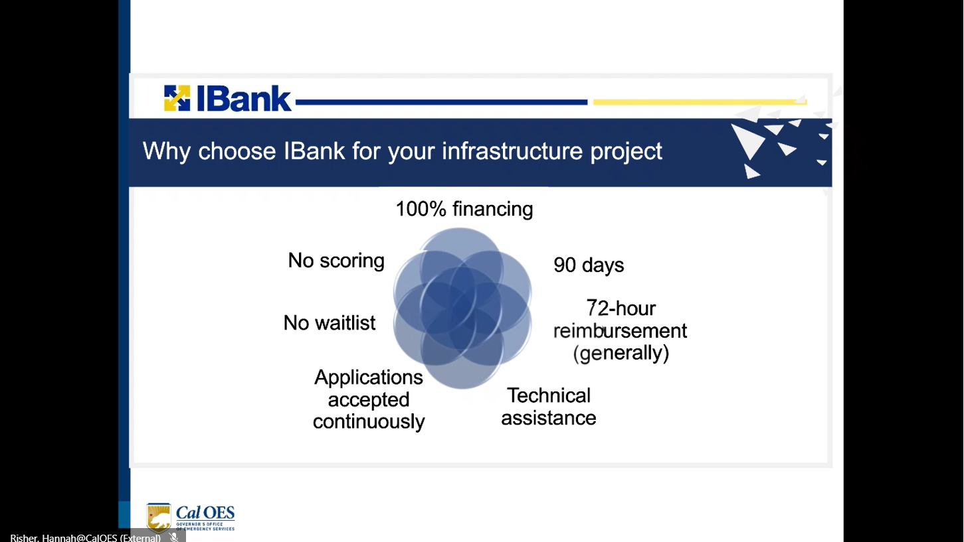
9
Notes:
Lina Moeller (Unverified)I want to highlight a number of benefits for working with Ibank.Lina Moeller (Unverified)First of all, our interest rates are very competitive.Lina Moeller (Unverified)They're based on the municipal index or the MMD scale. We provide subsidies based on Community based criteria such as median housing income, unemployment rate, or if it's an underserved designated area. You can get up to 25 basis points and interest rate subsidies. We also provide environmental or.Lina Moeller (Unverified)Climate related subsidies.Lina Moeller (Unverified)Because we as I mentioned earlier align ourselves to the governor's goals.
Lina Moeller (Unverified)You'll be assigned to a loan officer, and I'm of course involved in all the projects, but you'll have me and a loan officer that'll be working directly with you. And as I mentioned, you get 100% financing on these projects.Lina Moeller (Unverified)We also do not run out of money because we issue our own isof bonds. If we do run out of money, we use our.Lina Moeller (Unverified)Balance sheet equity.Lina Moeller (Unverified)The I bank balance sheet equity to fund these projects.Lina Moeller (Unverified)And then when we issue bonds, we reimburse ourselves and those are called bond anticipation loans.Lina Moeller (Unverified)We do those as well. So. So in other words, you don't run out of money.Lina Moeller (Unverified)The application window is full, the full 12 months. We don't have a, you know, specific period when we can do these loans.Lina Moeller (Unverified)We're pretty much first come first serve basis during the whole year.Lina Moeller (Unverified)We are AAA rated and because of that our cost of funds tend to be lower.Lina Moeller (Unverified)And we pass those savings on to you.Lina Moeller (Unverified)And also there's a lot of transparency.Lina Moeller (Unverified)Here, you know, we're working with you each step of the way and we try to be as transparent as we can.Lina Moeller (Unverified)And I've also mentioned earlier about the resolutions that would be required, the reimbursement resolution, which is part of the borough's resolution I mentioned earlier. We also can look at recently we've received project enquiries where you've got financing, let's say from USDA or another lender or you've got.Lina Moeller (Unverified)Federal grants or state grants.Lina Moeller (Unverified)And we are being called upon to maybe bridge the gap in financing or it's taking a long time for grants or federal grants to really come in the door, even though you've been approved.Lina Moeller (Unverified)We can in that situation start looking at maybe a short term loan for you for two or three years.Lina Moeller (Unverified)So those are some of the different ways that
Lina Moeller (Unverified)Balance sheet equity.Lina Moeller (Unverified)The I bank balance sheet equity to fund these projects.Lina Moeller (Unverified)And then when we issue bonds, we reimburse ourselves and those are called bond anticipation loans.Lina Moeller (Unverified)We do those as well. So. So in other words, you don't run out of money.Lina Moeller (Unverified)The application window is full, the full 12 months. We don't have a, you know, specific period when we can do these loans.Lina Moeller (Unverified)We're pretty much first come first serve basis during the whole year.Lina Moeller (Unverified)We are AAA rated and because of that our cost of funds tend to be lower.Lina Moeller (Unverified)And we pass those savings on to you.Lina Moeller (Unverified)And also there's a lot of transparency.Lina Moeller (Unverified)Here, you know, we're working with you each step of the way and we try to be as transparent as we can.Lina Moeller (Unverified)And I've also mentioned earlier about the resolutions that would be required, the reimbursement resolution, which is part of the borough's resolution I mentioned earlier. We also can look at recently we've received project enquiries where you've got financing, let's say from USDA or another lender or you've got.Lina Moeller (Unverified)Federal grants or state grants.Lina Moeller (Unverified)And we are being called upon to maybe bridge the gap in financing or it's taking a long time for grants or federal grants to really come in the door, even though you've been approved.Lina Moeller (Unverified)We can in that situation start looking at maybe a short term loan for you for two or three years.Lina Moeller (Unverified)So those are some of the different ways that we can help you to get these projects done.Lina Moeller (Unverified)With that next slide, please.Lina Moeller (Unverified)I just want to leave you with our ibank website I bank

Slide 10
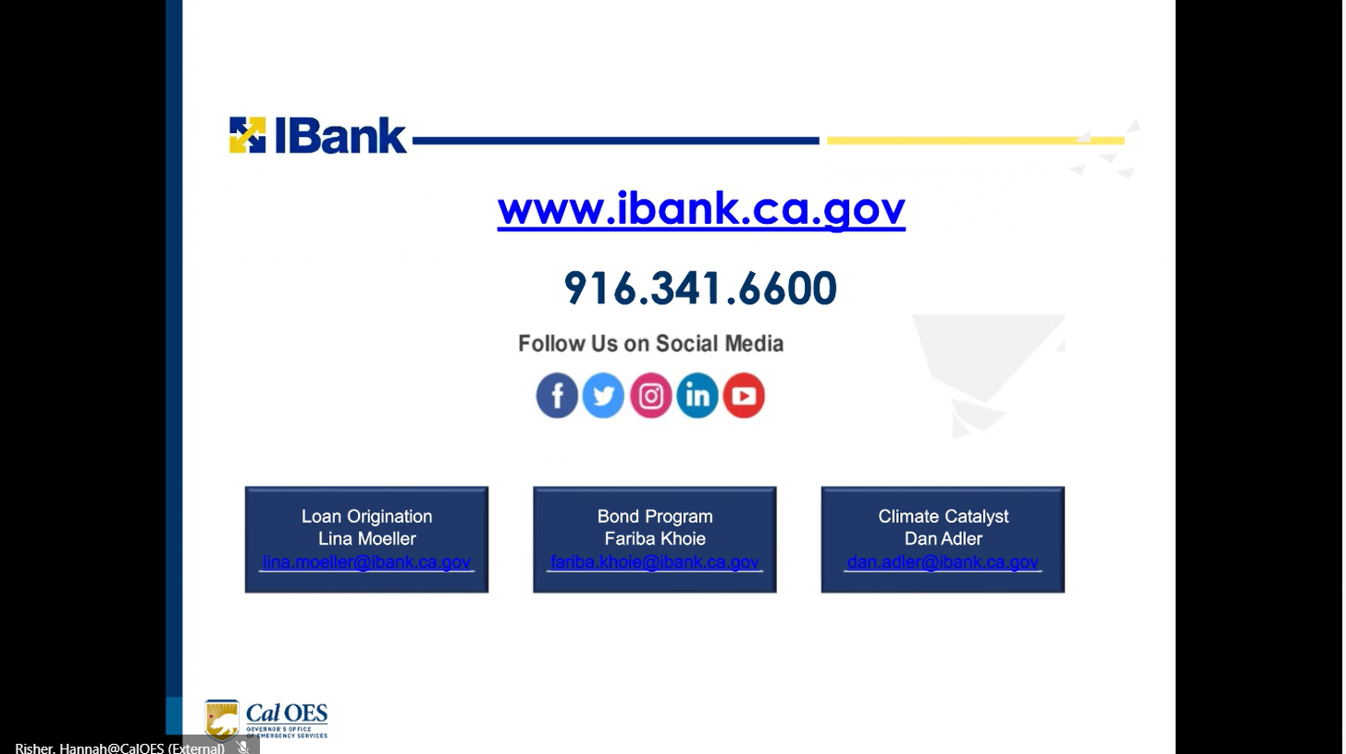
10
Notes:
IBank website: ibankdot.ca.gov. It's a really good resource. You can take a look at the ISRF loans, the bond unit projects that have been done, you can see small business loans, all our climate catalyst loans, you can see pictures, you can see testimonies on what kind of loans we finance, we bring a lot of experience to the municipal lending and we want to be creative in our underwriting. We try to find a way to help and structure alone so they can help local governments.
Question: Are you able to match funding with grants or other payment sources?
Answer: Yes, we can - we can match funding that is an eligible use.
To give attendees an idea of more of an idea of what projects these can be applicable for, I've coordinated with Ibank on various road projects that counties have had. There have been storm water or flooding projects as well - it's really a wide variety of different infrastructure issues that can be addressed through the IBank program and the beauty of using a loan with public assistance is that it doesn't knock you out of eligibility so if you were to use IBank, you would still be able to get public assistance through FEMA.
We've done projects where, because of climate change, there's been various regional systems, like water systems or wastewater systems where areas have been submerged. That's climate mitigation type project, along with storm water.
Question: How does IBank support tribal nations or how can it?
Answer: Tribal nations are not an eligible use, so at this time, IBank really doesn't have a way to help tribal entities. We do get enquiries periodically and ISRF is not an eligible source, but our climate group could potentially help. The climate group has a different source of money so if it's climate related project, then feel free to reach out to me and I will connect you with the climate financing team.

