Slide 1


FY 25-26 OWP Development and Coordination – Statewide MPO Meeting

Slide 2

Agenda
– Welcome
– Federal Priorities and Updates
– OWP Development and Monitoring 04 – General Updates
05 – Next Steps 06- Questions

Slide 3
Federal Priorities and Updates

Slide 4
Federal Priorities and Updates
FHWA UPDATES
Federal Certification Reviews
  Addressing federal actions and findings in the OWP
Federal Planning Grants in the OWP
BIL/IIJA Implementation
  Transportation planning for special events (SPR)
  Complete Streets local match waiver

Slide 5
Federal Priorities and Updates
CALTRANS UPDATES
Federal Planning Emphasis Areas
  Have remained the same from last year
FLMA Coordination
  FHWA and FTA have emphasized the importance of asking MPOs to enhance coordination with Federal Land Management Agencies (FLMAs). We are asking MPOs to be proactive about these relationships, especially if your region overlaps with federal lands.
  The 2024 MPO RTP Guidelines has a list of the federal land agencies that MPOs should aim to coordinate with. This will help ensure smoother planning and funding access for future projects.

Slide 6
OWP Development & Monitoring

Slide 7
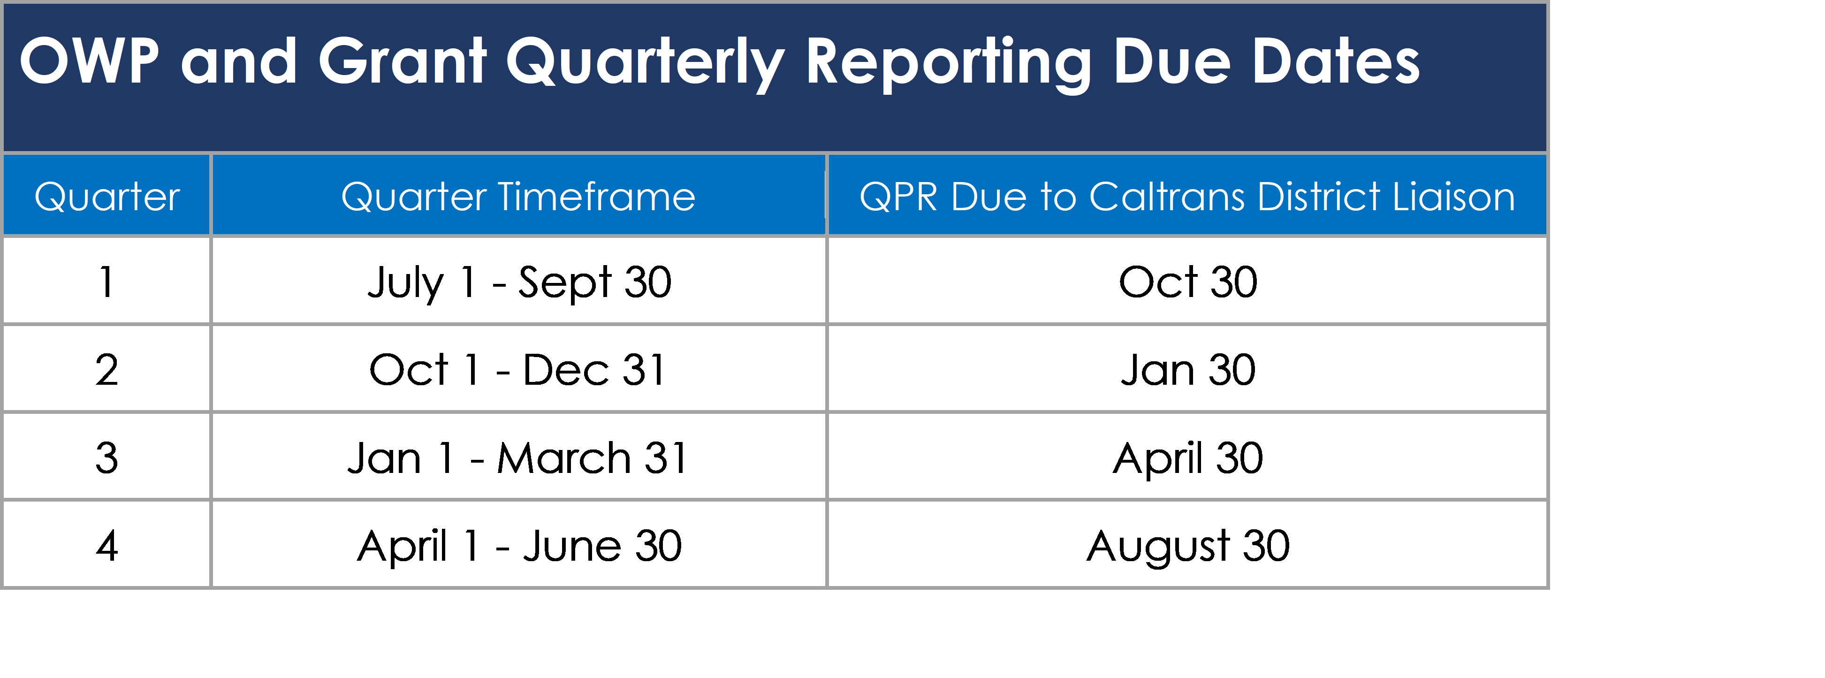
Quarterly Progress & Expenditure Reports
UPDATES TO THE QPRS
QPR due dates:
  Quarters 1-3 QPRs due 30 days after the close of the quarter
  Quarter 4 QPR due 60 days after the close of the quarter
Other notable revisions/clarifications:
  QPRs are required to have a narrative describing work progress, progress in adhering to schedules, and a list of tasks and products completed during the quarter.
  A percent comparison of actual performance with work-element goals and deliverables (this should not be a percent comparison of funding expended)
  A status of expenditures by work element, funding source, and type, in a format compatible with the work program, including a comparison of budgeted amounts and costs incurred.

Slide 8
Complete Streets Set-Aside
Each MPO must allocate at least 2.5% of FHWA PL funds toward CS activities
Beginning FY 25-26, MPOs will be able to use both FHWA PL and FTA 5303 funds for CS activities and will be able to apply a CS local match waiver on those funds, above and beyond the 2.5% minimum requirement
Also, beginning FY25-26, MPOs will be able to waive the local match requirement for CS activities for eligible projects funded under the Strategic Partnerships grants (FHWA SPR & FTA 5304)
MPOs must submit a request for Caltrans to review the proposed work elements and must have Caltrans approval prior to initiating work

Slide 9

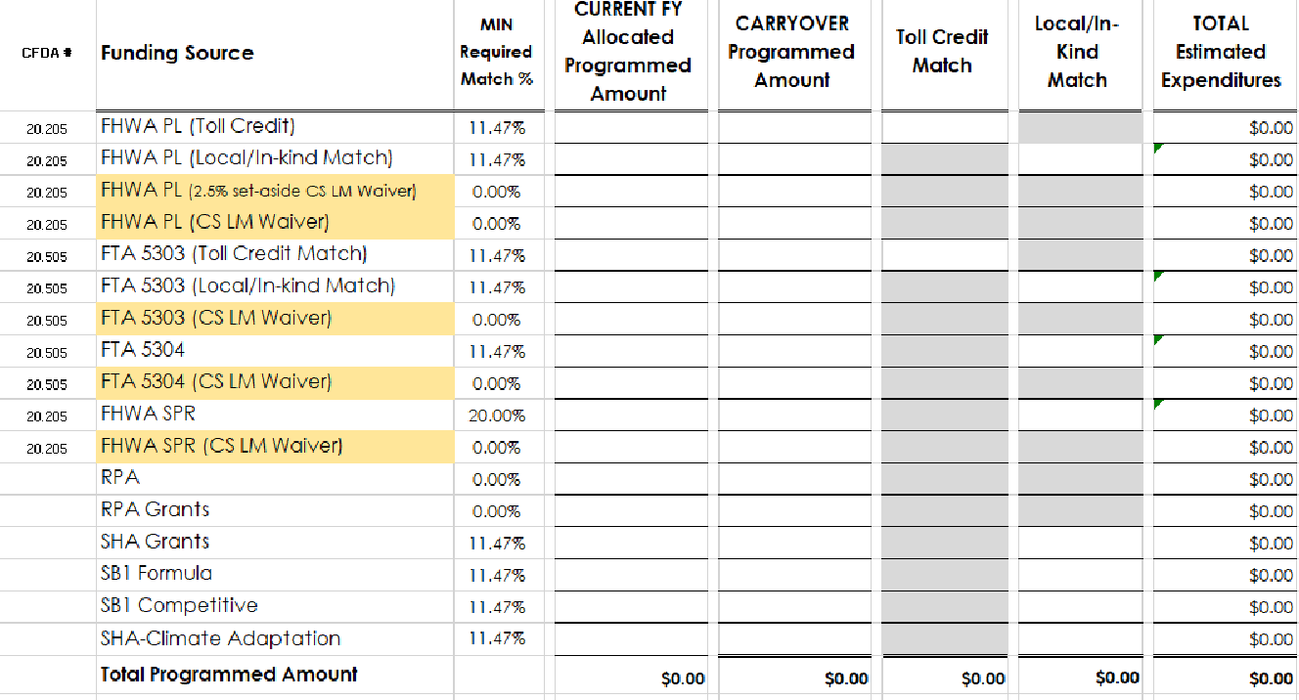
Updated OWPA
Beginning FY 25-26, we will be utilizing a revised OWPA form which has new rows for tracking the CPG funds that are using the CS local match waiver.
We will share this out beginning in the new year, because it will also have the updated years for the MFTA

Slide 10

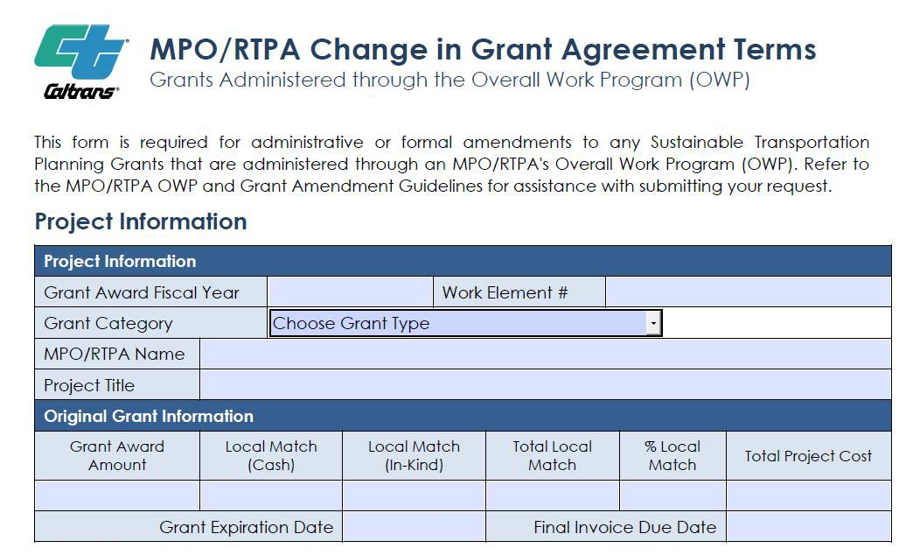

Grant Amendments
We have streamlined the grant amendments process to reduce administrative burdens.
The Change in Grant Agreement Terms (CAT) form will no longer be required.
After the grantee has programmed the grant into the OWP and has received the Notice to Proceed, grant amendments no longer require submittal of the Scope of Work or Cost and Schedule

Slide 11
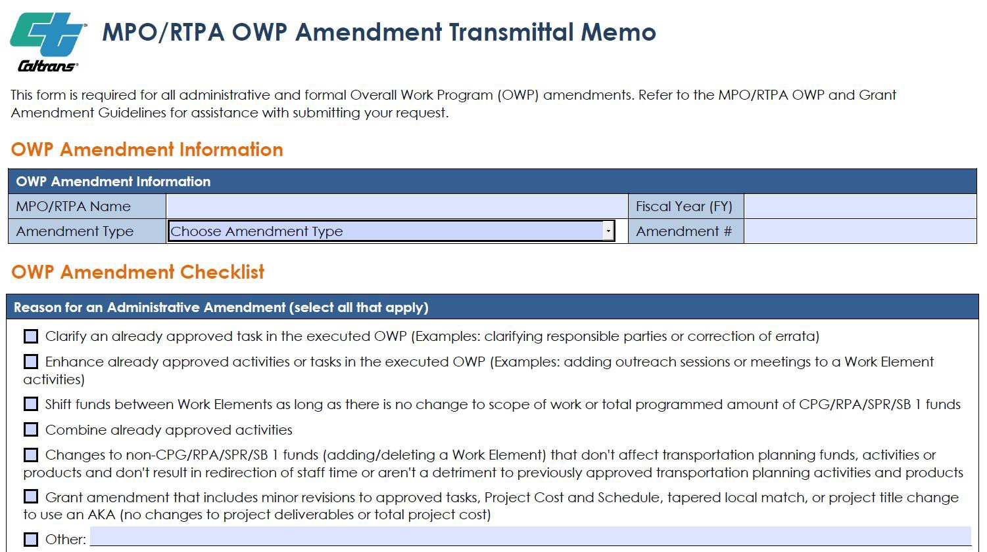

Grant Amendments
All grant amendments will be reviewed and processed via the OWP Amendment Transmittal Memo.
Minor budget changes at the task level don’t need to be reported, unless task budgets shift by +/- 20%
Minor schedule changes – under 5 months – can be reported via the QPRs. If there are major delays, contact your Caltrans DL to determine if an OWP amendment is needed.

Slide 12
Final Products
Final Products are required to be submitted at the end of the Fiscal Year during the year-end closeout process, consistent with 23 CFR 420.117 and 49 CFR Part 18 of the Uniform Administrative Requirements
MPOs must include tangible deliverables in the OWP work elements that will be submitted to Caltrans

Slide 13
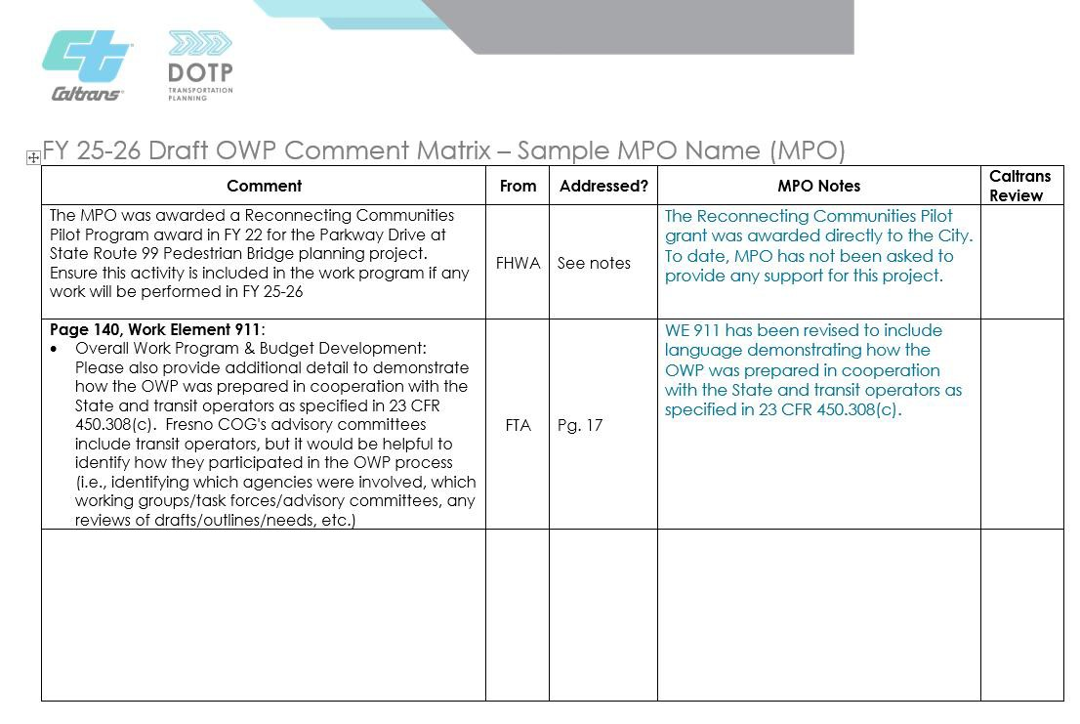
Incorporating Comments into the OWP
This upcoming FY, FHWA and FTA have requested that Caltrans submit a comment matrix which identifies which comments were addressed or not addressed from the MPOs draft OWP comment letter
We are updating the comment letter format so that MPOs can properly respond to each comment

Slide 14
Certification Review Findings
MPOs are being asked to include their responses and actions in response to the
certification review findings and recommendations in their OWP introductions.
Caltrans will be specifically reviewing the draft and final OWPs to ensure each MPO, that is a TMA, has this included in their OWP.

Slide 15
General Updates

Slide 16
California Transportation Plan Updates

Slide 17
Federal Liaison Updates

Slide 18
Regional Planning Handbook Update
ORCP is continuing to work on the Regional Planning Handbook update
We are currently reviewing the revisions as a team
Once finalized, we will be working with the graphics team on the design and formatting
We anticipate, the handbook update to be finalized by the end of this calendar year

Slide 19
Master Fund Transfer Agreement Update
The MFTA Boilerplates have been finalized.
MPOs and RTPAs are to present these boilerplates to their board and provide a board resolution adopting the MFTA.
  If you have not submitted a board resolution yet, please do so as soon as possible as this is required to execute the final MFTAs.
The individualized final MFTAs, which include the agency’s name and new MFTA number, are being prepared by the Division of Procurement and Contracts (DPAC).
  The DPAC contract analyst will be emailing the MPO executive directors with the final draft of the MFTA and the appendices.
  The analyst will request the name and email address of the reviewing attorney, as well as the approved Board Resolution if it is not already on file.
  Upon receiving the resolution and the attorney's details, the analyst will include the names of both the executive director and the reviewing attorney in the agreement.
  Finally, the DPAC contract analyst will route the agreement for signatures on the 2025 MFTA and its appendices via Adobe Signature, starting with the reviewing attorney and followed by the executive director.
  After executing the 2025 MFTA, please submit a new OWPA that includes the new MFTA contract number.

Slide 20
Next Steps

Slide 21
Individual OWP Development and Coordination Meetings
Caltrans District staff are currently working with each of the MPOs to schedule the individual OWP meetings.
These meetings should take place between now and late January.
MPOs should be prepared to discuss their prior year’s accomplishments, activities that will be carried over into the new FY, as well as present on any new activities we can expect to see in the Draft OWP.
This will also be an opportunity to ask any MPO-specific questions to Caltrans, FHWA, and FTA

Slide 22
Important Dates and Deadlines
Draft OWPs are due to Caltrans February 28, 2025
Final OWPs are due to Caltrans May 9, 2025
These are hard deadlines – FHWA requires 30 days to review and provide approval of the Final OWPs

Slide 23

QUESTIONS

